Slide 1

Bullying & Gangsterism
(a presentation by MCPF Penang)
www.mcpfpg.org

Slide 2
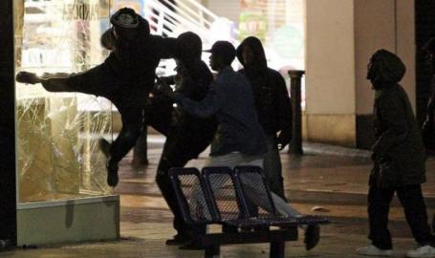
Bullying & Gangsterism
// How Can It Happen?
www.mcpfpg.org
The most common crime committed by youths is shop theft. Youths are also involved in violent crimes such as murder, rioting, extortion and unlawful assembly.
Offences like shoplifting,
extortion, etc., youths can also
become involved in gangs. This
can lead to serious and tragic
consequences, such as becoming
victims of rival gang clashes.
Most problem youths come from homes lacking in
parental guidance and are usually under-achievers
in schools and with low self-esteem.

Slide 3
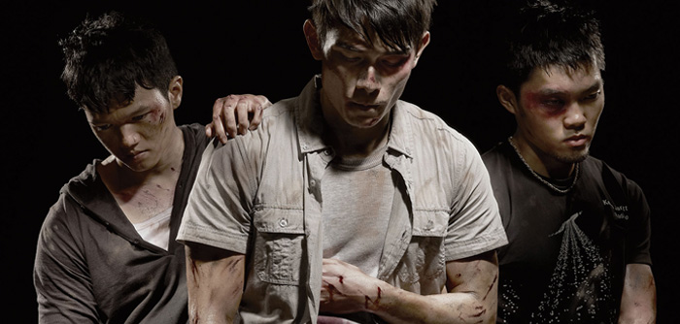
Bullying & Gangsterism
// Gang Involvement
www.mcpfpg.org
You are regarded as a gang member as long as you know that your friends are members of the gang and you continue to join them in their gang activities.

Slide 4
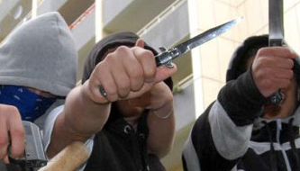
Bullying & Gangsterism
// Gang Involvement
www.mcpfpg.org
Such activities include:
  Gathering at the gang's operational ground.
  Recruiting or introducing new members to the gang.
  Accompanying gang members in
  outings.
  Being present with gang members
  during:
    Staring incidents.
    Settlements talks.
    Fights.
    Search of rival gang members to seek revenge.
    Funeral wake and procession of gang member or his
    relative, etc.

Slide 5


Bullying & Gangsterism
// Create a Lawful Society
www.mcpfpg.org
Members of the public who are concerned that their children may be involved in gang-related activities or have any information on such activities can call the Police Hotline at 03 - 2266 2222.

Slide 6

Bullying and Gangsterism
A short Awareness Presentation brought to you by:
Malaysian Crime Prevention Foundation
(Penang Chapter)
Visit us at www.mcpfpg.org for more information.

