Slide 1
MCPF Penang – PDRM Penang Community Outreach Program 2014
MCPF Penang “COP” 2014 Sunday 07th Dec 2014 GAMA Supermarket and Department Store
Co-Sponsored by:
Supported by:

Slide 2
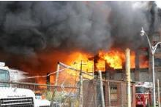
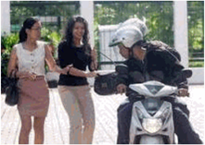
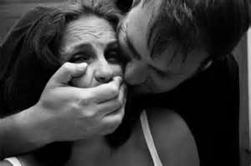
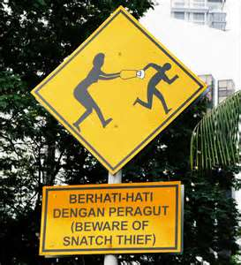
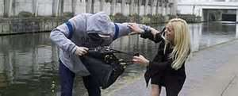
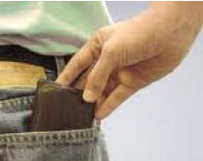
Themes
CHOSEN PROGRAM THEME: “CRIME PREVENTION – BE PREPARED, BE SAFE!” “CEGAH JENAYAH – SELAMAT DAN BERWASPADA!”
INCORPORATING PENANG PDRM THEME: “War against Crime Together with the Public” – Penang PDRM Theme
“Memerangi Jenayah Bersama Masyarakat”
Co-Sponsored by:
Supported by:

Slide 3
MCPF Penang Community Outreach Program 2014: 07th December 2014 – GAMA Supermarket & Departmental Store
11:00 am PDRM / MCPF Crime Prevention and Rotary Club of George Town Interactors Exhibits commences
1:30 pm Arrival of Guests
1:45 pm Arrival of VIPs
2:00 pm Arrival of YDH SDCP Dato’ Abd. Rahim bin Hj. Hanafi, CPO Penang and YBhg Dato’ Syed Jaafar Syed Ali, MCPF Penang
2:10 pm Welcome Address by YBhg Dato’ Syed Jaafar Syed Ali, Chairman – MCPF Penang
2:20 pm Keynote Speech by YDH SDCP Dato’ Wira Abd. Rahim bin Hj. Hanafi, CPO Penang
2:35 pm Official Launching of MCPF Penang Community Outreach Program 2014 “Crime Prevention – Be Prepared, Be Safe!” by YDH SDCP Dato’ Wira Abd. Rahim bin Hj. Hanafi, CPO Penang accompanied by YBhg Dato’ Syed Jaafar Syed Ali, Chairman – MCPF Penang and Yg Berusaha Encik Johnny Michael Tan, Organizing Chairman, COP 2014
2:40 pm Presentation of Token of Appreciation to YDH SDCP Dato’ Wira Abd. Rahim bin Hj. Hanafi, CPO Penang; and other Distinguished VIPs
2:45 pm Demonstration #1 by PDRM (Snatch Theft)
3:00 pm Walkabout and Meet-and-Greet the Public by PDRM/MCPF/GAMA (Launching Area/Ground Floor Supermarket)
3:10 pm Tour of PDRM & MCPF Crime Prevention Exhibits and Rotary Club of George Town Exhibit
3:15 pm Quiz Session / Lucky Draw
3:20 pm High Tea Reception/Press-Media Conference for VIPs and Press-Media @ GAMA Board Room / VIP Room
3:44 pm Demonstration #2 by PDRM (Self-Defense by PDRM Full Gear Team)
3:55 pm Departure of YDH SDCP Dato’ Wira Abd. Rahim bin Hj. Hanafi, CPO Penang
4:30 pm Quiz Session / Lucky Draw
5:00 pm End of Program / Event of the Day
Co-Sponsored by:
Supported by:

Slide 4
MCPF Penang Provisional Sub-Committee for “Community Outreach Program 2014”
No | Name | MCPF | Remarks
1 | Dato Syed Jaafar Syed Ali | MCPF Pg Chairman | Advisor “COP 2013”
2 | Johnny Michael Tan | MCPF Pg SLC Member | Org Chairman “COP 2013”
3 | Dato’ Pulayantran Keyambu | MCPF Pg SLC Member; MCPF Central EXCO Member | “New Resource”
4 | Rahumat Ibrahim | MCPF Pg Treasurer | Committee Member “COP 2013” (wef OC Mtg #2)
5 | ASP Azmi Shukor | MCPF Pg Secretary | “New Resource” (wef OC Mtg #3)
6 | Maj. (H) M. Kaleessvaran | MCPF Pg SLC Member | Committee Member “COP 2013”
7 | James Mohan | MCPF Pg SLC Member | Secretary “COP 2013”
8 | Harikumar Katherasen | Co-opted Sub-Committee Member | Treasurer “COP 2013” / Retained
9 | Joseph Sawaremuthu | Co-opted Sub-Committee Member | Publicity Collateral “COP 2013”
10 | Lion Choo Eng Hin | MCPF Pg SLC Member | “New Resource”
11 | Lion Felix Chuah | MCPF Pg SLC Member | Committee Member “COP 2013” (wef OC Mtg #2)
12 | Jeffri bin Jaafar | MCPF Pg SLC Member | “New Resource”
13 | Mohd Nizam bin Mohd Noor | MCPF Pg SLC Member | “New Resource”
14 | Rosli Ali | MPF Pg SLC Member | Committee Member “COP 2013” (wef OC Mtg #3)
15 | ASP Haizan Abdullah | Co-opted PDRM Appointee | Proposed / appointed by YDH ACP Mior Faridalathrash Bin Wahid, OCPD Timur Laut
16 | To Be Appointed | Co-opted PDRM Appointee (SPT Event) | To be determined
Team Members from GAMA Supermarket and Department Store: Ms Anna Foo; Mr. Neoh Kean Bin; Ms Ng Yee Mai and Mr. Joseph Tan
Rotary Club of George Town: Rotarian Don Law Note: MCPF Exhibit Sub-Team – 1 Co-Opted Sub-Team Member: Mr. Selwyn Chuah
Supported by:
Co-Sponsored by:

