Slide 1

Outrage of Modesty
(a presentation by MCPF Penang)
www.mcpfpg.org

Slide 2
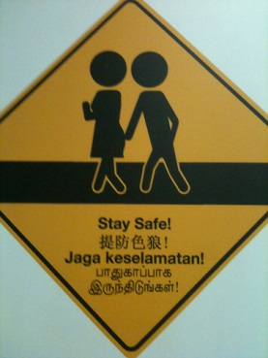
Outrage of Modesty
// How Can It Happen?
www.mcpfpg.org
Young girls have been molested or raped on their first date by people they had met online or through phone calls.
It can happen:
  At lifts, corridors, dark and lonely places;
  On public transport, e.g. buses, MRT trains, etc;
  Crowded places, e.g. rock concerts, star performances
  etc.

Slide 3
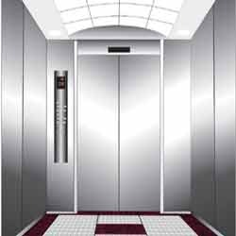
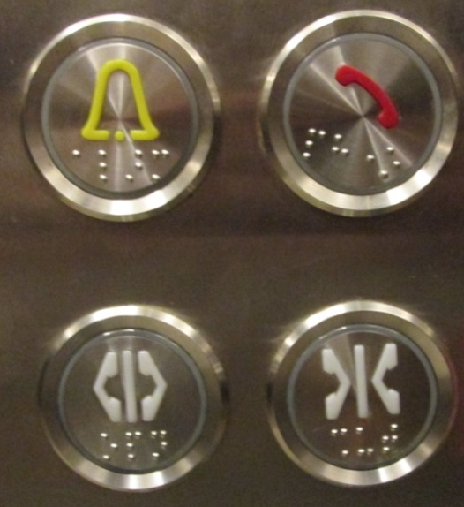
Outrage of Modesty
// Preventive Measures
www.mcpfpg.org
Never enter a lift with a stranger. Let the stranger take the lift and wait for the next one.
If alone in the lift, stand near to the lift buttons. Press
“Door Open” and exit if a stranger rushes in as the door is
closing.

Slide 4


Outrage of Modesty
// Preventive Measures
www.mcpfpg.org
Sit close to the aisle when using public transport.
Remain alert, do not nap or sleep while travelling alone.
Never take short cuts through dark, deserted places.
Keep to well-lit areas where there are people and traffic.
Don’t jog in secluded areas.

Slide 5



Outrage of Modesty
// Preventive Measures
www.mcpfpg.org
Always be alert and attentive to the surroundings. If you suspect that you are being followed, remain calm and proceed to the nearest open business premises crowded area or call the Police.
Do not be accept offer of lifts or presents, from strangers who approach you on the pretext of asking for directions or help, etc.
Never reveal information about yourself and your family online.

Slide 6
Outrage of Modesty
// What To Do If It Happens?
www.mcpfpg.org
While on the bus, alert other passengers or seek help from the driver if someone is making you uncomfortable or touching you inappropriately.
Young girls should alert their parents if they had been molested.
If you are confronted by a molester, stay calm and take note of his/her appearance, attire, height, or any other distinctive
physical features.
Call the Police as soon as possible so that the Police
can reach the location quickly to assist you.

Slide 7

Outrage of Modesty
A short Awareness Presentation brought to you by:
Malaysian Crime Prevention Foundation
(Penang Chapter)
Visit us at www.mcpfpg.org for more information.

