Slide 1

Snatch Theft
(a presentation by MCPF Penang)
www.mcpfpg.org

Slide 2
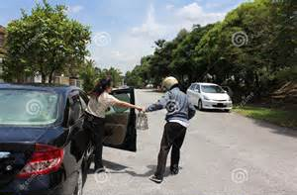

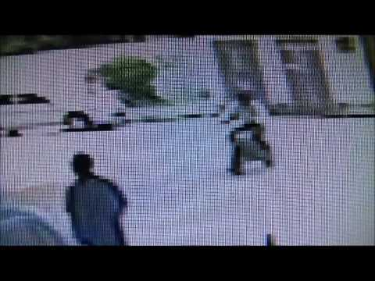
Snatch Theft // How Can It Happen?
www.mcpfpg.org
1. Approaching the Targeted Victim by:
Starting a Conversation;
Seeking Assistance;
Asking for donations
2. Snatching from behind when the Target (victim) is:
Walking (Street, Mall, or
Hawker Centres);
Boarding or Alighting from Vehicles;
Entering/Leaving a Public Toilet;
Refilling at a Petrol Station

Slide 3
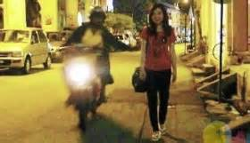

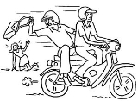
Snatch Theft // How Can It Happen?
www.mcpfpg.org
3. Dirtying the Target (clothes, or others), then offering to clean.
4. Lying (telling) the Target that his/her valuables
(money etc.) has fallen on the ground.

Slide 4
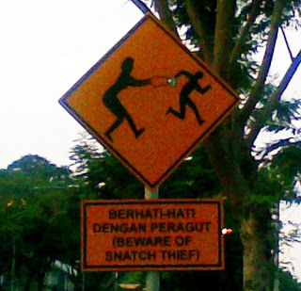
Snatch Theft // Preventive Measures
www.mcpfpg.org
Avoid ‘short cuts’ through dark or deserted areas;
Be wary of persons who follow or distract you;
Carry your handbag in front of you or clasp
it firmly under your arm;
Never leave your handbag unattended, especially in crowded places like shopping malls or hawker centres;
Always walk facing on-coming traffic if possible and hold the handbag on the side away from the motorists;
Avoid wearing excessive jewelry or carrying large amounts
of cash;
Do not flaunt cash and valuables in public view. Keep your valuables out of sight!

Slide 5
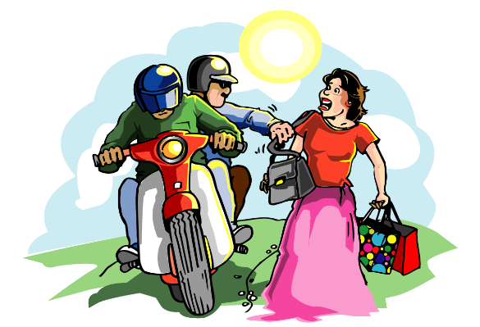
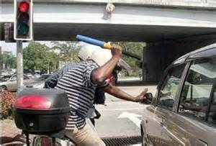
Snatch Theft // What to do if it happens?
www.mcpfpg.org
If a robber demands your valuables, hand them over - your life is worth more than your possessions;
Attempt to throw your handbag/valuables away from you
and run;
If you are robbed, try to remember the attacker’s face, the
license plate number (usually of a motorcycle). This information
could help protect others, and;
Report all incidents of snatch thefts to the police.

Slide 6

Snatch Theft
A short Awareness Presentation brought to you by:
Malaysian Crime Prevention Foundation
(Penang Chapter)
Visit us at www.mcpfpg.org for more information.

