Slide 1

Vehicle Theft
(a presentation by MCPF Penang)
www.mcpfpg.org

Slide 2
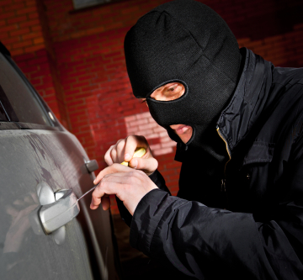
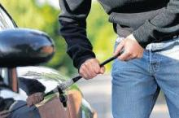
Vehicle Theft
// How It Can Happen?
www.mcpfpg.org
1. The Thief tampers with the doors and windows of the car;
or with the keyhole;
Or smashes the windows or windscreen.
2. The Thief uses an ignition key of
another vehicle, or;
3. The Thief a piece of metal strip or tools to
force open car doors.

Slide 3

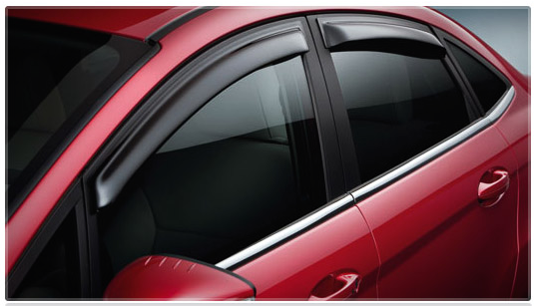
Vehicle Theft
// Preventive Measures
www.mcpfpg.org
Park in well-lit areas;
Install an anti-theft system;
Use additional locking devices
for example disc brake lock for
motorcycles;
Wind up all windows and close all
doors of your vehicle, even if it is
left unattended for a short while;

Slide 4
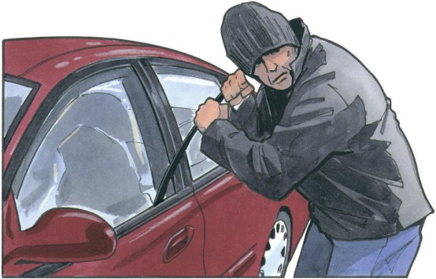

Vehicle Theft
// Preventive Measures
www.mcpfpg.org
Remove the ignition key and lock your vehicle before you leave, even if it is for a short while. Do not leave your ignition key inside the vehicle;
Ensure that your vehicle has been secured properly and look around the vicinity for suspicious characters before leaving.
If you see any suspicious characters, take note of their appearance, attire, height, or any other distinctive
physical features and inform the Police for assistance. Do not confront them.

Slide 5

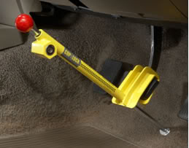
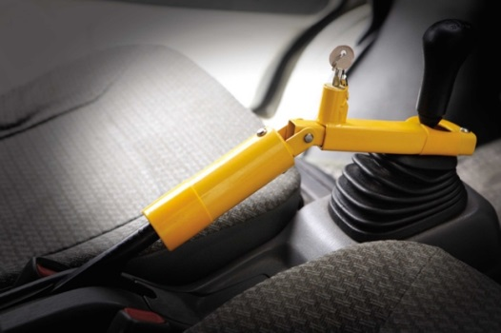
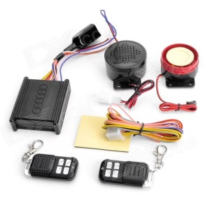
Vehicle Theft
// Recommendations
www.mcpfpg.org
The following are recommended for Cars, Vans, and Lorries
  Steering wheel lock
  Clutch lock
  Brake lock
  Gear lock
  Anti theft alarm system

Slide 6
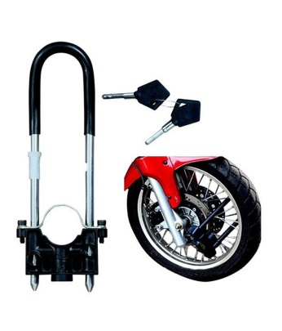
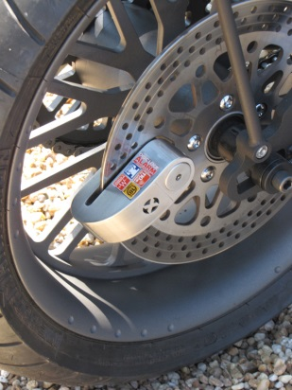
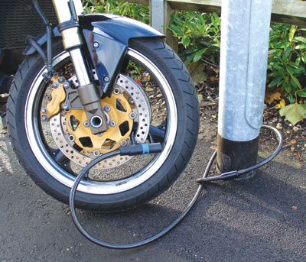

Vehicle Theft
// Recommendations
www.mcpfpg.org
The following are recommended for Motorcycles
  Front wheel safety lock
  Cable lock
  Disc or Sprocket lock
  Shackle lock

Slide 7

Vehicle Theft
A short Awareness Presentation brought to you by:
Malaysian Crime Prevention Foundation
(Penang Chapter)
Visit us at www.mcpfpg.org for more information.

