Slide 1
Brief Report Out on
23rd MCPF AGM
Dewan Sultan Ahmad Shah
Maktab PDRM Kuala Lumpur,
43200 Cheras
KUALA LUMPUR
Saturday, 26th March 2016
Summary
by
JM Tan
Secretary, MCPF Penang

Slide 2
In Attendance:
TOTAL REGISTERED MCPF MEMBERS IN ATTENDANCE: 174
TOTAL MCPF PENANG ATTENDEES: 16 (9.2%)
MCPF Penang SLC Members
MCPF Penang Ordinary Members
101059_Dato’ Syed Jaafar Syed Ali
171173_Dato’ K. Pulayantran
101849_Assoc. Prof Dr. P. Sundramoorthy
101889_Dato’ Ong Poh Eng
101947_Maj (H) M. Kaleessvaran
101960_Johnny Michael Tan
101978_Munusamy Muniandy
101051_(Jimmy) Choo Chin Nam
101967_(Sunny) Peh Ee Sun
102003_Paramguru Balan a/l Morgan
102083_Ronald Cecil Aeria
102093_Mohamed Azmi Aboo Haniffa
102122_(Thomas) Goh Eng Wah
102138_Leong Kin Weng
102139_(Davin) Lee Yew Keong
102167_Kathiraveloo a/l Thangiah

Slide 3
Key Messages from YAB Dato’ Seri Dr Zahid Hamidi, Deputy PM, Minister of Home Affairs and MCPF Chairman
MCPF – critical in supporting image enhancement of PDRM. The Police cannot do it alone (Crime Prevention).
Funding for 2016 (from MCPF EXCO Meeting in Kuching 12/3/16)
  ‘One-off Additional Grant: RM 3,000,000
  Annual Allocated Grant: RM 2,000,000
  TOTAL Funding: RM 5,000,000
Having Funding is one thing. More important is the COMMITMENT and SPIRIT of MCPF / Members.
Major changes to MCPF Constitution to incorporate MCPF at District / Division levels. To mirror the existing 157 Polis Districts.

Slide 4
Key Messages from YAB Dato’ Seri Dr Zahid Hamidi, Deputy PM, Minister of Home Affairs and MCPF Chairman
Working in cognizance with other Governmental Agencies is also critical.
Society at large is MCPF’s “3rd Party Partners”.
MCPF is NOT a POLITICAL Party. “Leave Politics outside of MCPF”.
MCPF must be seen as a True MALAYSIAN entity.
Work TOGETHER as a TEAM…
We are ONE! Act as ONE!
We need to CREATE and SUSTAIN “Good CREDIBILITY”.
An Extraordinary General Meeting will be scheduled to specifically finalize the changes in the current MCPF Constitution.

Slide 5
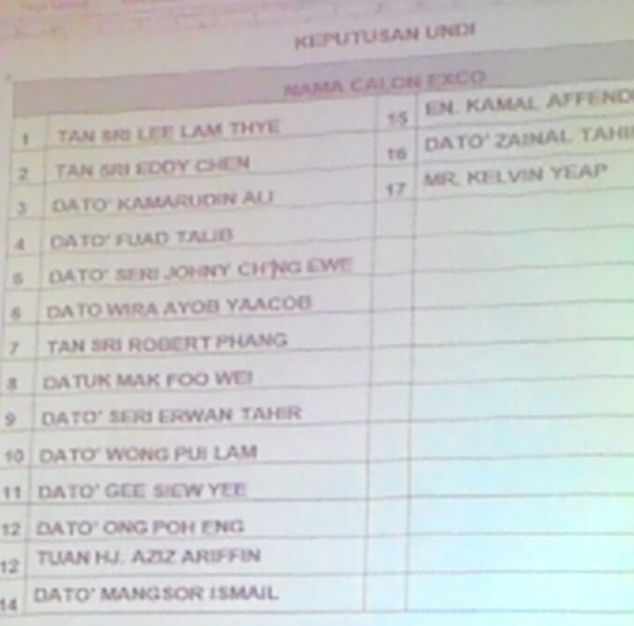
CONGRATULATIONS TO:
Dato’ Ong Poh Eng on being nominated and voted in as one of the new 17 MCPF Federal EXCO Members per Article 8 (d).
Assoc. Prof Dr. P. Sundramoorthy on being re-appointed as an ex-officio Executive Council Member per Article 8 (c) (ii).

Slide 6
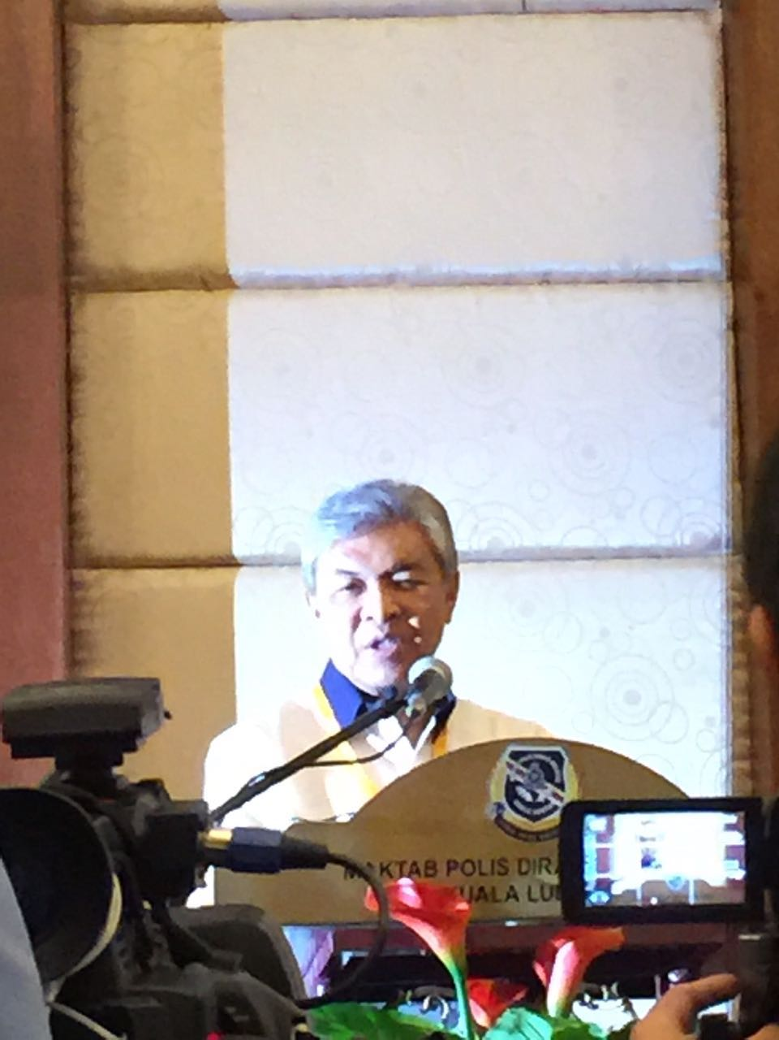
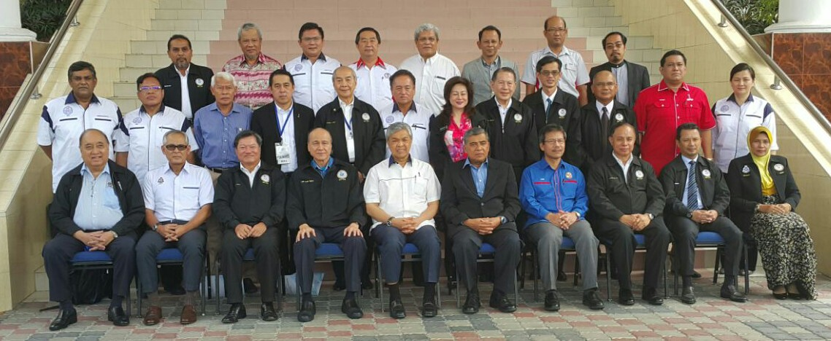
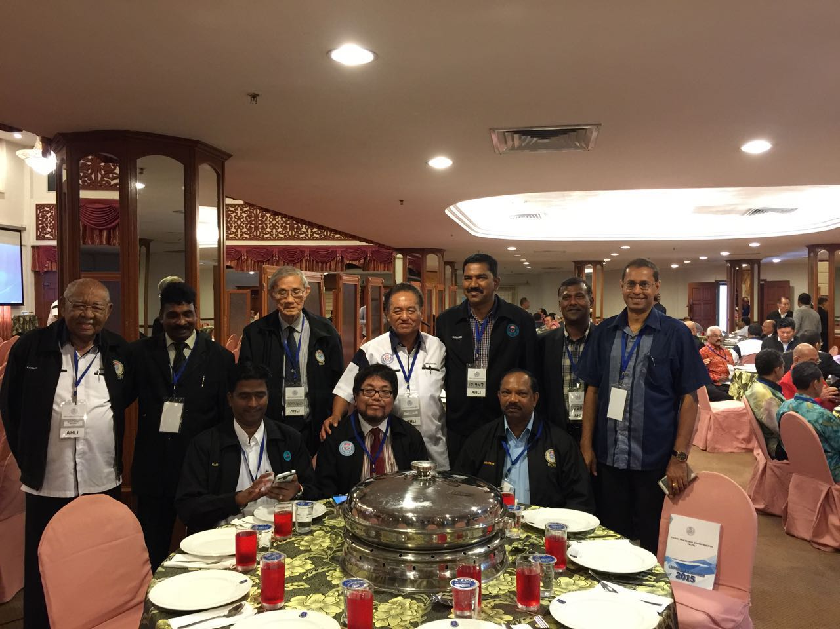
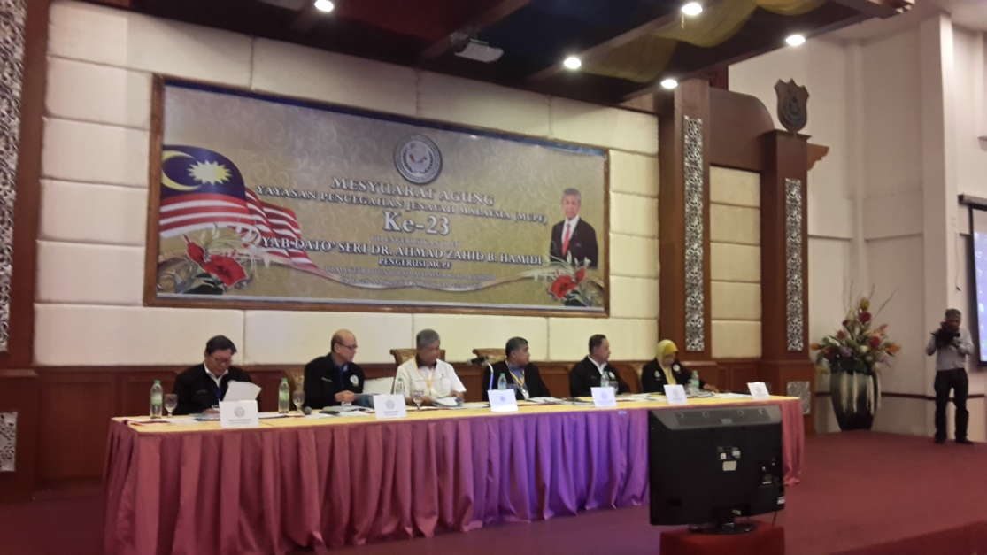
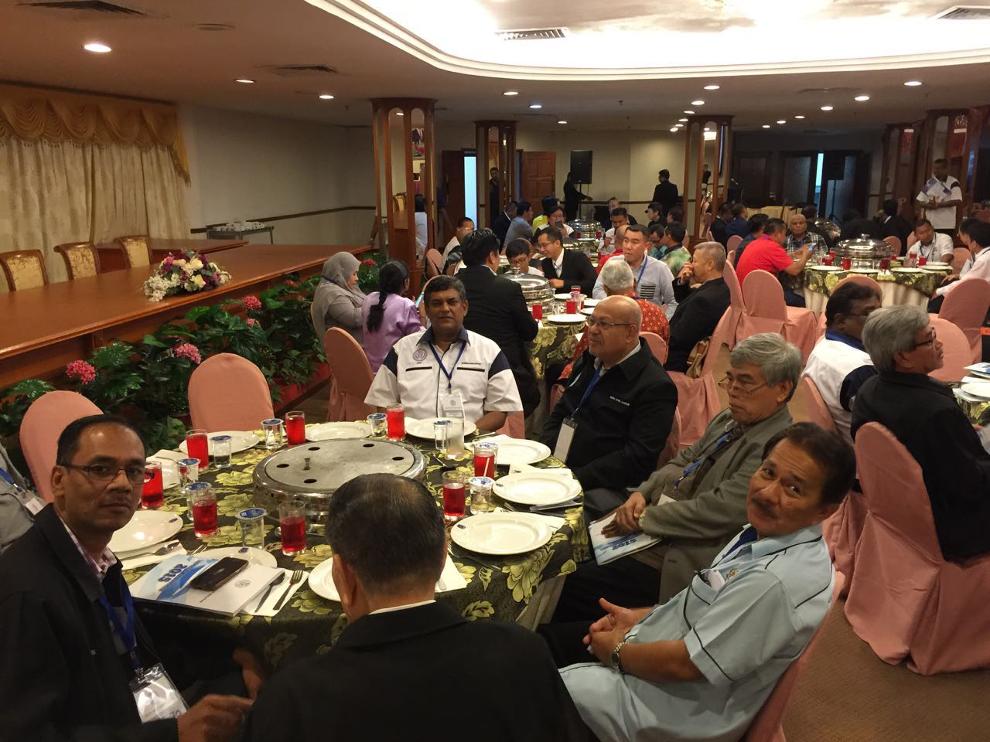
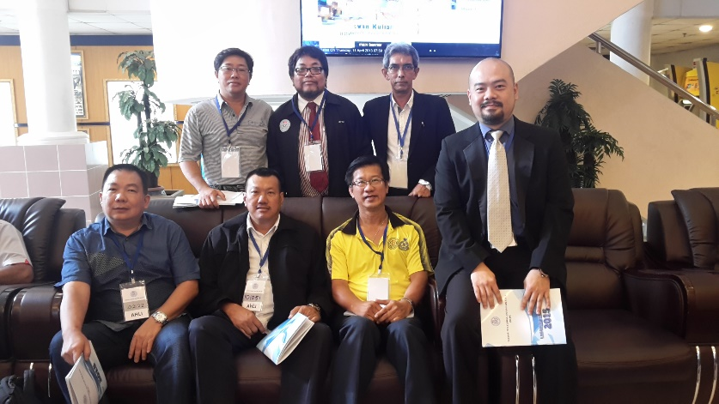
Some selected Pictures:

Slide 7
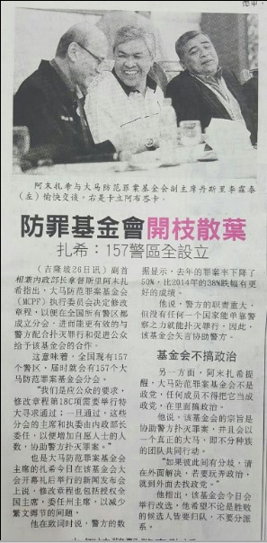
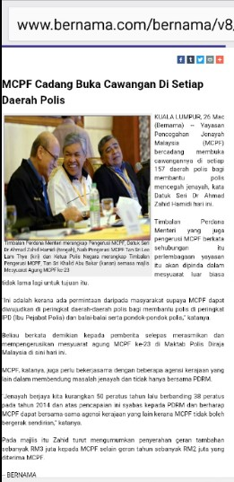
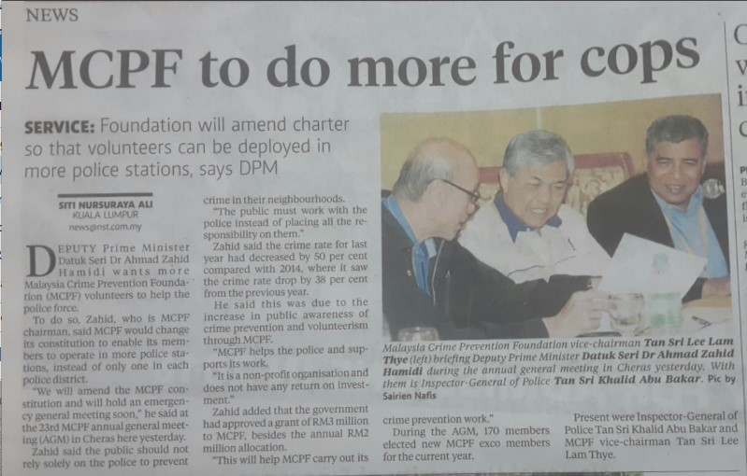
Selected Press Releases:

