Slide 1

Welcoming Dinner by
MCPF Penang for
YDH CP Dato’ Abdul Ghafar bin Rajab, Chief Police Officer, Penang
Murai 1 & 2, Hotel Equatorial, Penang
Monday 7th March 2016
8:00 pm to 11:00 pm
A Summary by: JM Tan, Secretary, MCPF Penang

Slide 2
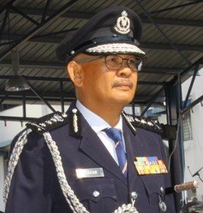


TAHNIAH & SELAMAT DATANG!
YDH CP Dato’ Abdul Ghafar bin Rajab
Chief Police Officer, Penang

Slide 3
Event Overview:
Malaysia Crime Prevention Foundation Penang State Liaison Committee warmly welcomed the newly appointed Chief Police Officer of Penang YDH CP Dato’ Abdul Ghafar bin Rajab with a dinner at Hotel Equatorial, Penang on Monday March 7th 2016.
Highlights included:
  Introduction by the Organizing Chairman Associate Professor Dr. P. Sundramoorthy;
  Welcome Speech and Keynote Address by YBhg Dato’ Syed Jaafar Syed Ali, Chairman, MCPF Penang;
  Appointment of YDH CP Dato’ Abdul Ghafar bin Rajab as the Advisor, MCPF Penang;
  Appointment of Associate Professor Dr. P. Sundramoorthy to the post of Vice-Chairman (I), MCPF Penang;
  Appointment of YDH SAC Abdul Rahman bin Ibrahim, Head of Crime Prevention and Community Safety Department, Royal Malaysia Police, Penang (JPJKK) as Vice-Chairman (II), MCPF Penang
  Symbolic Cake Cutting Ceremony to underline the symbiotic relationship and collaborative working spirit between the Royal Malaysia Police and Malaysia Crime Prevention Foundation
  Overview of MCPF Penang Main Activities and Events for 2015 by JM Tan, Secretary, MCPF Penang as a sharing for the new CPO as well as his Heads of Departments and OCPDs who were in attendance on the night

Slide 4
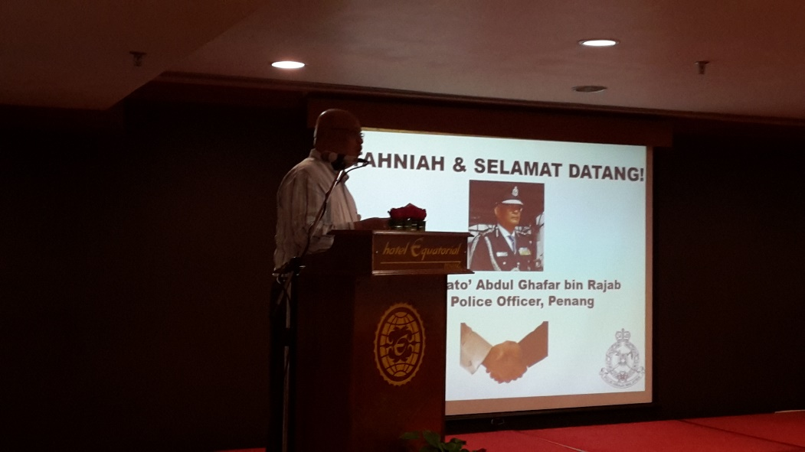
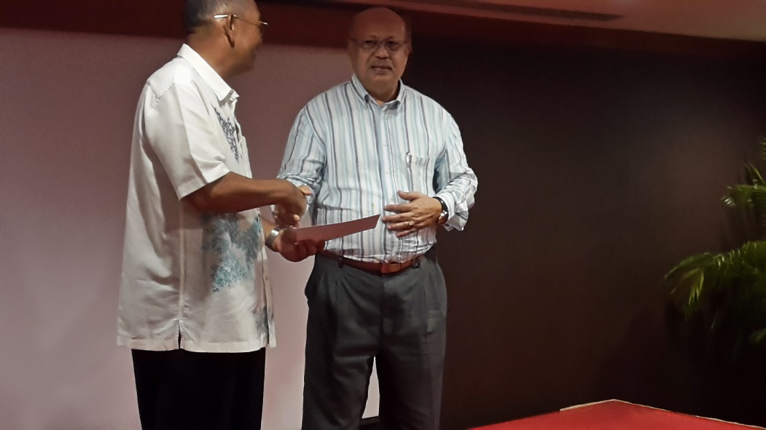
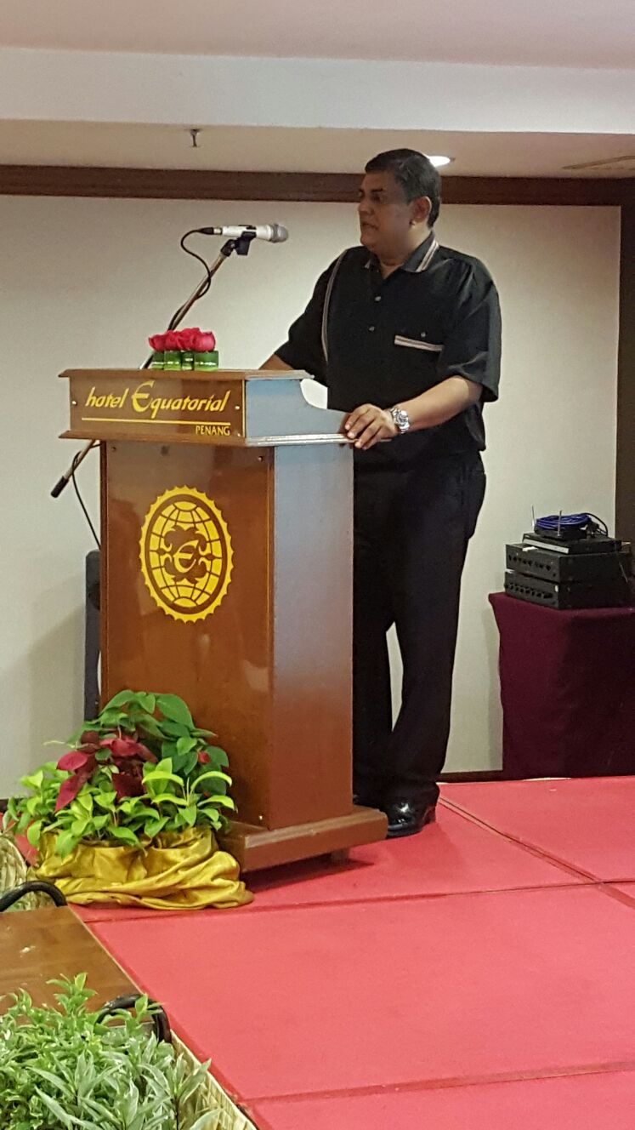
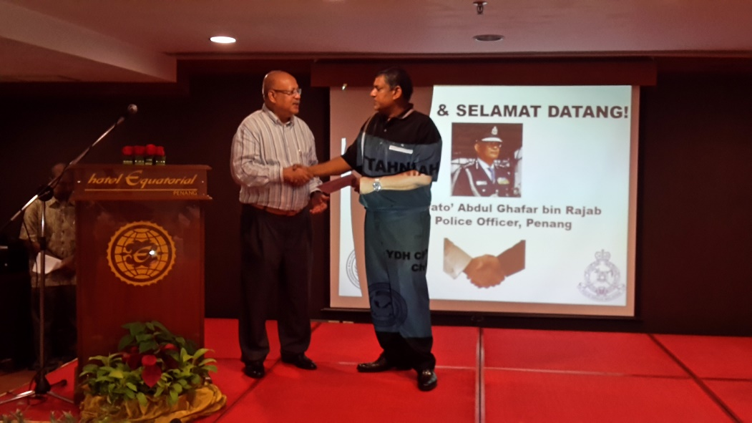
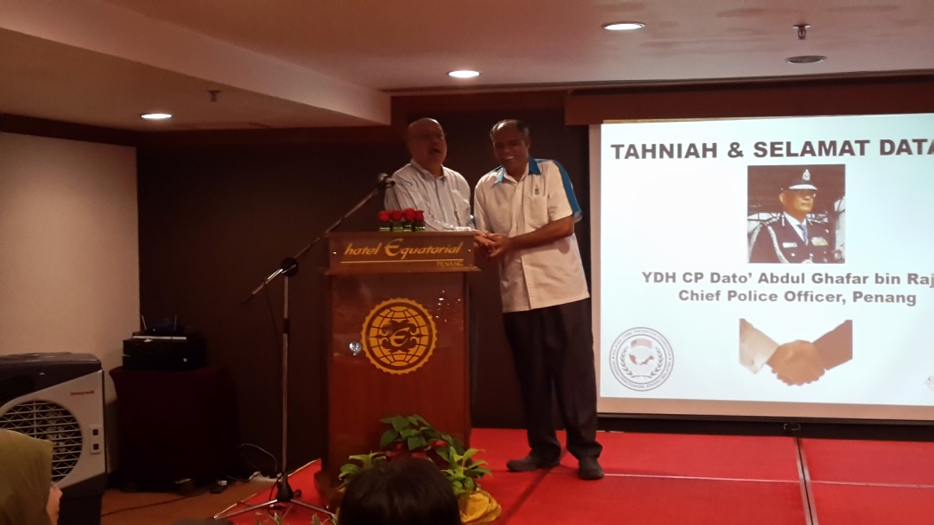
Event Highlights – Key Moments in Pictures
Official Welcoming Speech by YBhg Dato’ Syed Jaafar Syed Ali, Chairman, MCPF Penang
Welcome On Board Dear Advisor
YDH CP Dato’ Abdul Ghafar bin Rajab, CPO, Penang
Event Chairperson Speaking to the Crowd!
Steady Dr. P. Sundramoothy!
Congratulations Dr. P. Sundramoorthy –
Vice-Chairman (I), MCPF Penang!
Syabas and Tahniah YDH SAC Abdul Rahman bin Ibrahim as our Vice-Chairman (II), MCPF Penang

Slide 5
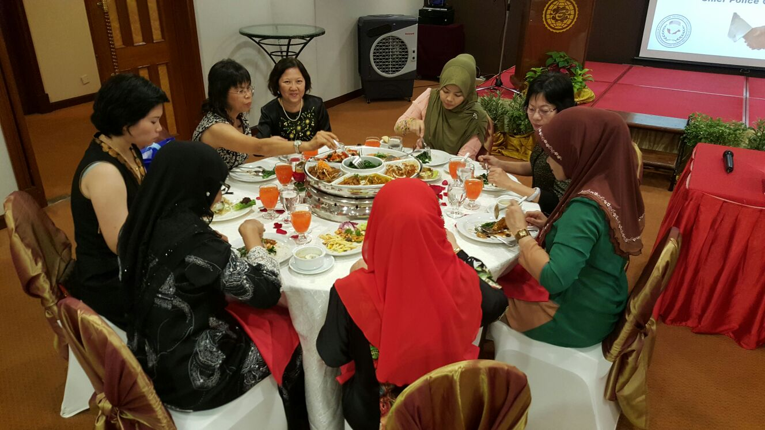
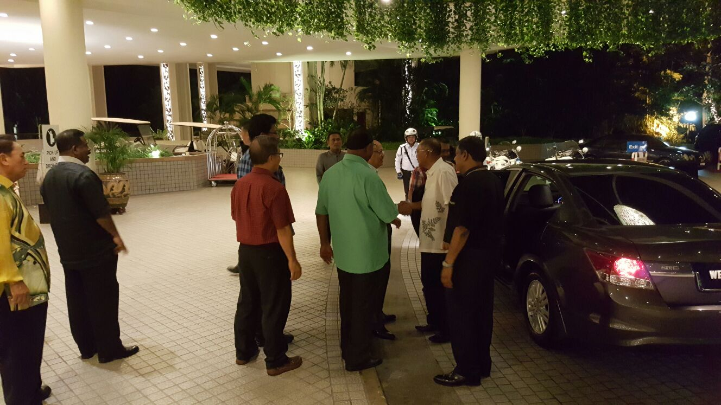
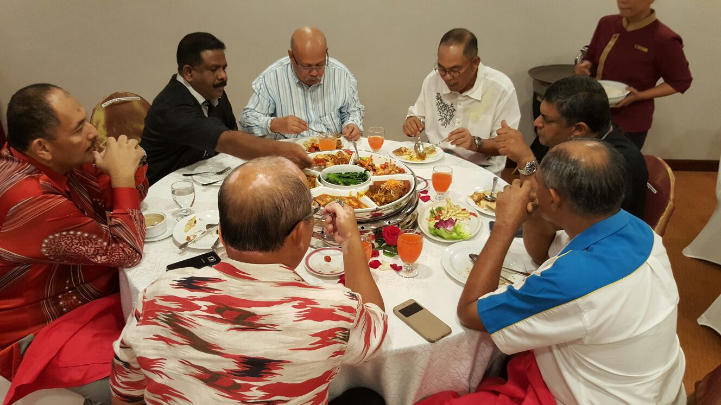
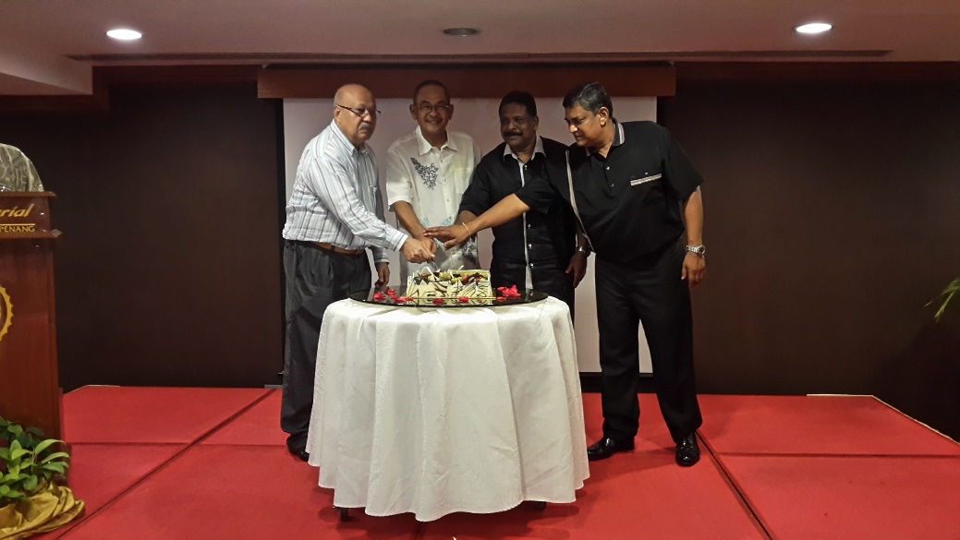
Event Highlights – Photographic Captures
The ‘Better’ Halves!
Welcome and Selamat Datang!
YDH CP Dato’ Abdul Ghafar bin Rajab
All The Good Men!
Celebrating Symbiotic Synergy!

Slide 6
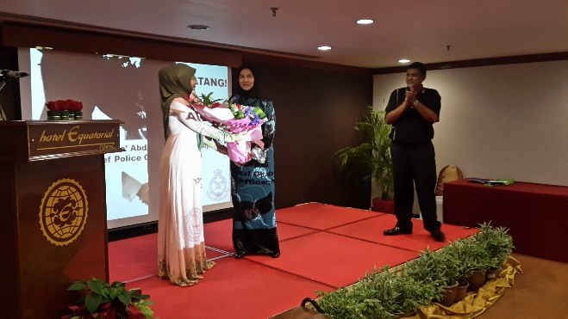
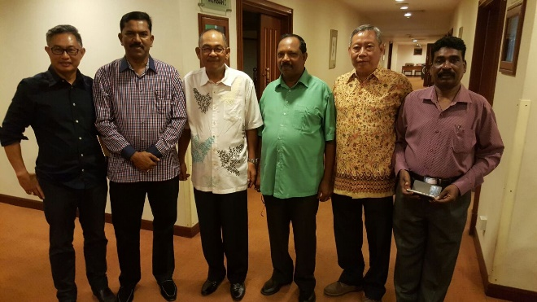
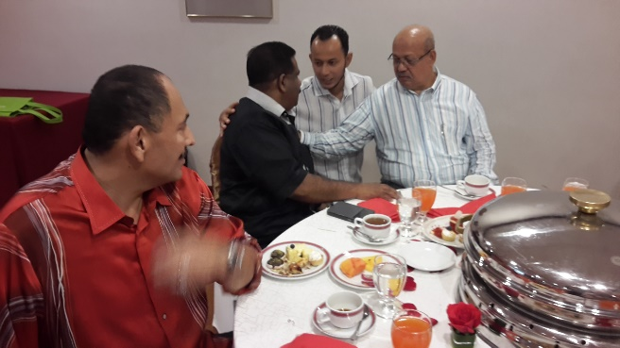
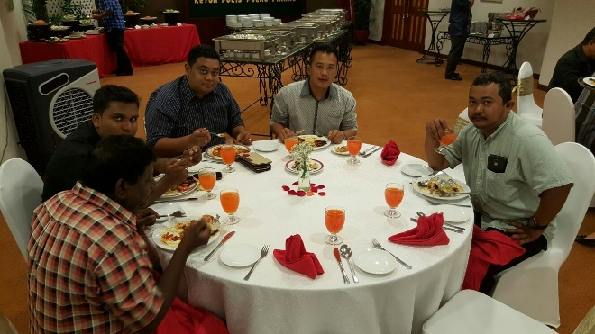
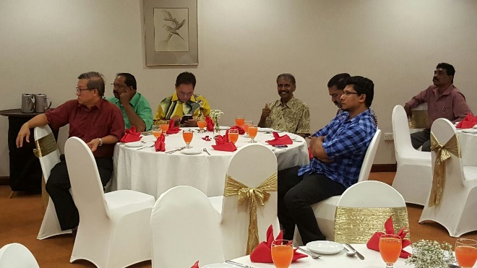
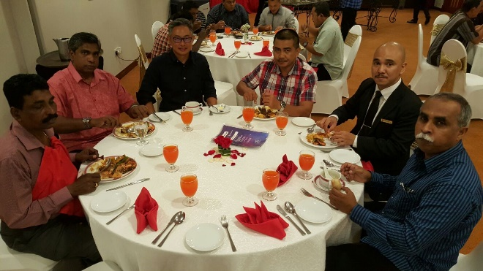
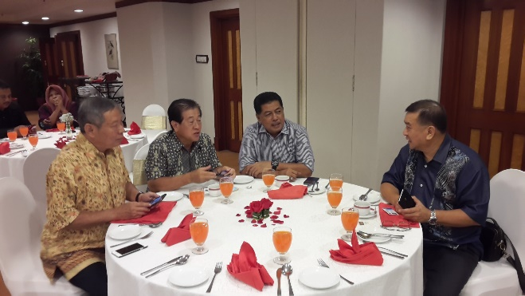
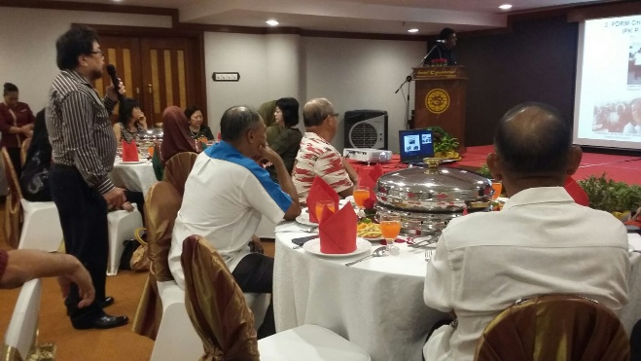
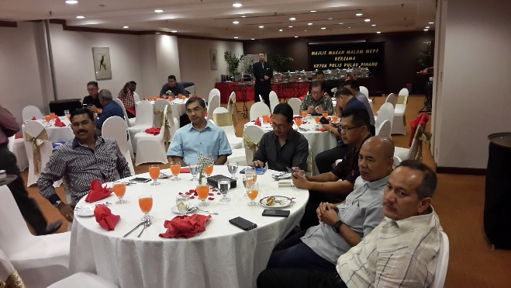
Event Highlights – More Memories… Clasped between the pages of our Minds!

